Slide 1
CISCO PACKET TRACER

Slide 2
Cisco Packet Tracer is a powerful network simulation program that allows to experiment with network behavior.
Develop important graphical representations
of networks.
Animate networks by adding data packets

Slide 3
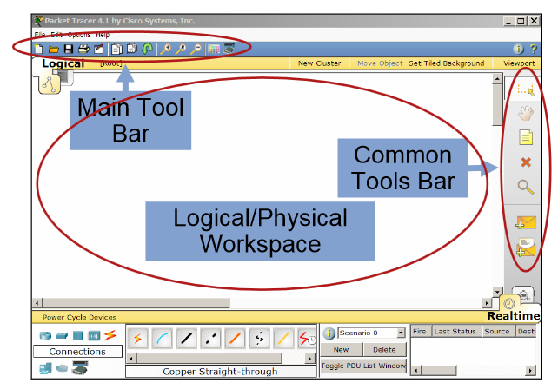
CISCO PACKET TRACER

Slide 4
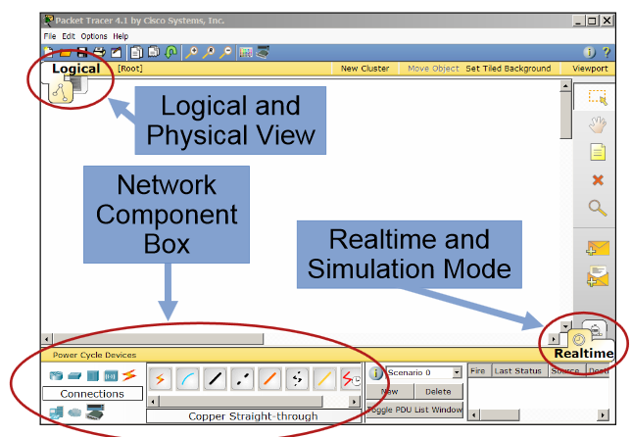

Slide 5
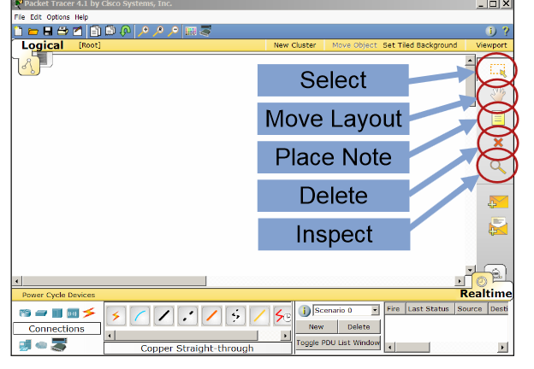

Slide 6
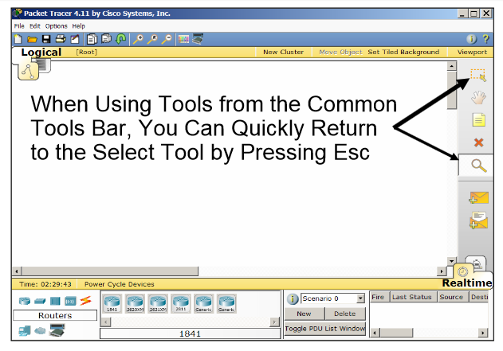

Slide 7
